Slide 1
FILE STRUCTURE AND EXISTING DATA CAPTURING TECHNIQUE
Rural Cadaster

Slide 3
Activity (individual 15 points)
Create file structure / database
Scan document (i.e., FRF, field/sketch map).
collect existing ortho-photo
Scanned
Georeferenced
Create the required feature layers
Kebele
Road
River
parcel
Correction
Check for errors (geometry and attribute)
Edit errors
Produce maps
Index map
Adjudication map
Document and present the process

Slide 4
Creating File Structure
File structure is an arrangement of folders/files in a chronological order. All the QGIS data is stored, manipulated, interpreted and analyzed based on data structure.
In principle Field registration Forms and Sketched Field Maps shall be scanned and stored in systematic archives.
The advantage of the original paper-based filing system was that you really had to think about where to put files so that you could locate them easily when they were needed.
When your files are digital, you can’t see or touch them. It becomes too easy to have files scattered all over your computer. Since this is a digital mess and not a physical mess, often you don’t realize you have a problem until you have a problem!
You don’t feel the pain of a disorganized system until you can’t find a file you need.

Slide 5
There are three overarching goals for your file organization system:
Easy to File: You don’t want your filing system to be a huge, hierarchical maze. You want it to be fast and easy to save files so your system does not cause friction.
Easy to Find: You want your system to make it easy to find the file or folder you need, either by poking through folders or using search.
Reusable: Where possible, you want to use re-usable templates and naming conventions, both of which support the previous two goals.

Slide 6
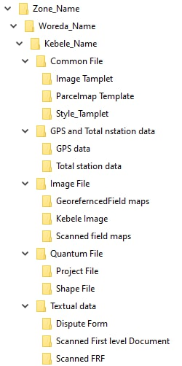
Proposed structure
Your proposal?
File structure pays important role to organize all your documents carefully both paper and electronic files; so that you can find them quickly and easily.
Data/ documents: such as GPS data, Total Station data, Filed Map, other scanned documents, etc

Slide 7
The following are key tips for organizing organizational document in appropriate file structure
Avoid saving unnecessary documents.
Follow a consistent method for naming your files and folders.
Store related documents together, whatever their type.
Separate ongoing work from completed work.
Avoid overfilling folders.
Organize documents by date.
Make digital copies of paper documents.

Slide 8
Scanning Field Registration Format
?
Notes:
Digital scanning refers to optical and electronic processes that capture and convert printed materials to digital format. Scanning is one component of a larger document imaging system that includes image-capture, storage, display, and retrieval capabilities. Document imaging systems typically differentiate between page imaging and text imaging, the most common types. Increasingly, however, the scanning industry has been leaning toward enhanced functionality, whereby single scanning systems are capable of scanning images, text documents, and even positive and negative film. Page scanners rely on bitmap images while text images rely on Optical Character Recognition (OCR).
Scanning technology relies on photoelectric measures of light and dark to create bitmapped displays. The number of total photoelectric sensors and the amount of information contained about each pixel combine to create gray scale and resolution. The conversion of sensor data to digital format is obtained through the use of an analog-to-digital converter. The resulting digital information may be manipulated, stored, retrieved, or displayed on request as a digital mirror image of the original.
Scanner components typically include document input or reading devices, scan engines, and scanning software. Desktop digital scanners rely on either flatbed or sheet-fed operations to input hard-copy printed materials into digital form. Scanning engines incorporate cylinders and drums to record digital information, and frequently use charge-coupled devices (CCDs). Scanning software enables manipulation of both text and images. Using special scanning software, text recognition or optical character recognition (OCR) translates printed alphabetical symbols to digital words. These digital words may be edited or manipulated with a word processing software package. All scanning is to be done in A4 or A3 format, black and white, or colour (if stamps or signatures are in blue ink), density of 300 dpi and output format pdf.

Slide 9
Scanning Field Map/Sketched Maps
The scanner resolution should be adjusted to maintain the quality of the scanned document. Resolution is a measure of how much image detail information the scanner is to capture in a scan. A higher resolution results to a sharper image but requires more disk space for file saving (600 dpi).
After scanning the document, the scanned document should be saved using the recommended type of file format such as TIFF.
The orientation can be fixed using rotate the picture if needed so that North is up. Take out the picture from the scanner to be able to see where North is. Close Picture Viewer when you are finished.

Slide 10
Activity 2: OPERATING SPATIAL DATA

Slide 11
Setup the GIS environment
Install QGIS software and plugins.
Explore QGIS Graphical User Interface (GUI).
Customize QGIS.

Slide 12
Spatial data processing – in QGIS
Geo-reference scanned field maps/sketched maps. As much as possible use the ortho-photo
Create parcel geometry and feature extraction.
Encode and link the FRF data.
Edit attribute table.
Perform Spatial and attribute data query.
Apply geo-processing tools and techniques in QGIS.

Slide 13
Create the parcel layer - CRS
Select the specified CRS which is best fit in the specified area (Adindan/UTM zone 36N or 37N or 38N). For this project select zone 36N.
Define The Attribute New Field
In front of name write the attribute like (Region, Zone, woreda, kebele name, UPID, holder name, means of a question, acquisition date….).

Slide 14
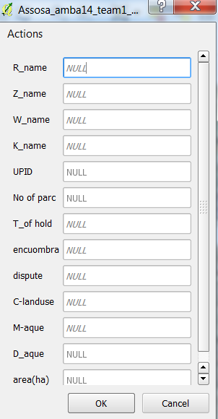
Attributes - parcel
Select the specified CRS which is best fit in the specified area (Adindan/UTM zone 36N or 37N or 38N).
Define The Attribute: including Region, Zone, woreda, kebele name, UPID, holder name, means of a question, acquisition date...

Slide 15
Preparation of Public Display Materials

Slide 16
Preparation of Public Display Materials
This includes the following main categories:
Public Display Map Preparation and Printing
Attribute table preparation and printing

Slide 17
Public Display Map Preparation and Printing
Public display maps, usually at a scale of between 1:2,000 showing all the defined parcels in a Kebele will be prepared to show the location and extent of holdings of the Kebele using the final merged parcel coverage (shapefile).
However, the decision on the public display map scale selection should depend on the visibility of all parcel’s geometry and related information on the map. The parcels on the map are labeled by the UPIN (HpIdParcel) of each parcel, as well as names of the first land holders.
For very small parcels (smaller than 0.05 Ha or <500 M²) only the UPIN (HpIdParcel) is printed to avoid congested labels that cover each other. The map of parcel boundaries is overlaid with the field map numbers to enable easy location of each parcel by the observer. Production of public display maps can be done by the responsible institutions (Federal, Region or Woreda) or it can be outsourced to printing companies.

Slide 18
General preparations and settings
First be sure that you have access to the land holder information. It could be either through the Full info shapefile (where the land holder is entered as an attribute) or through a separate cadastral database file that is greater or equal to 90% joined /connected to the shapefile.
Zoom out in the map view so that you see the full kebele.
The Object shape and Final kebele boundary should be visible well styled. If the Final kebele boundary is not finished, the approximate kebele boundary can be visible instead.
Make the Woreda, Kebele, Parcel’s layer visible. Woreda and Kebele as usual replaced by the current names for the location.

Slide 19
Creation of a Public Display Grid
Before going to create a public display, we must have:
Kebele field map index
Kebele Boundary map
Kebele Image and
Kebele shape file

Slide 20
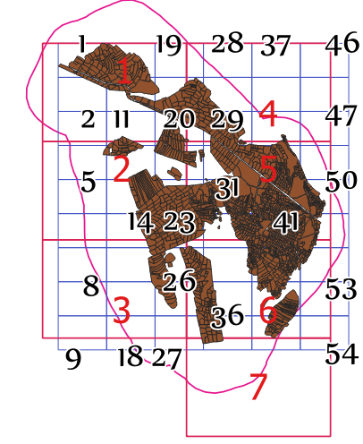
Public display grid index (red color) Field map index (blue color)

Slide 21
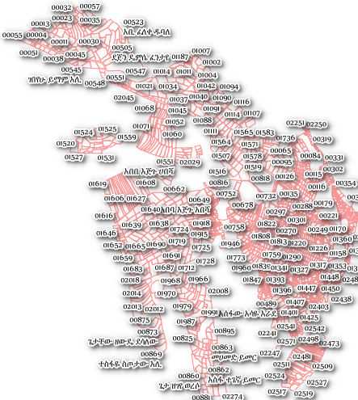
Parcels greater than 0.05 Ha can label with UPID and Holder name.

Slide 22
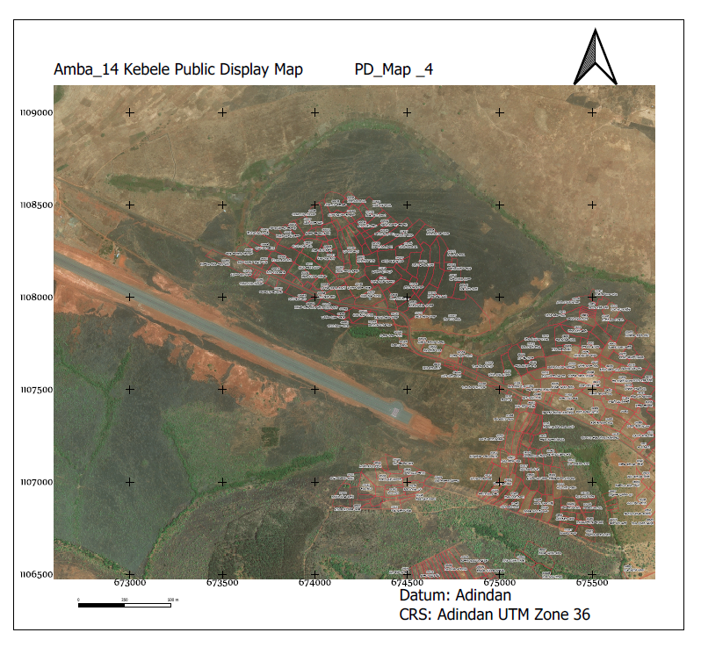
Public Display Map

Slide 23
Conformation and Correction
The overall planning, organization, and coordination of the public display management responsibility should be the Woreda land administration offices in cooperation with the respective KLAUC and Kebele administration organs.
Information requiring further verification needs to be field checked; minor corrections should be made in the office.
Some objections may need a court decision, or an existing court decision may need to be registered by the Woreda.

Slide 24
Assign at least eight people from the staff to:
give initial orientation to the land holders to find and check displayed information
record attendance
support land holders to check textual information in the list
support land holders to find their parcels on the index map
record minor errors and mistakes to be corrected (e.g. spelling mistakes, errors by data recorders)
record claims and objections that need further verification (e.g. errors by surveyors, objections requiring a court decision)
provide lap-top supported information (in cases where parcels are too small and a larger display scale is required)
collect signatures for confirmation of correct data

Slide 25
Actvity
Describe is the objective of public display.
From your experience, what are the steps in facilitating and leading public display?
What are the recommended paper size and scale in preparation of Public Display Overview Map?

Slide 27
RECOGNIZING THE CONCEPTS OF MAP
PRODUCING PARCEL MAP CERTIFICATE

Slide 28
Unit Objectives
Apply standard map elements.
Prepare parcel map based on the regional template
Print final parcel map certificate.
Parcel map issuing and documentation.

Slide 29
Applying Standard Map Elements
The most commonly used map elements are title, legend, scale, directional indicator, inset maps, grid and authorized body.
Currently, the Ethiopia rural land administration sector has their own map template/elements.
Among the nine Ethiopian region, three regions of rural land administration sectors (South nations, nationalities and peoples, Oromia and Amhara) regions are used as an example to show their map template/elements.
Their standard map element is shown in following maps. For detailed information refer to the attached reference material.

Slide 30
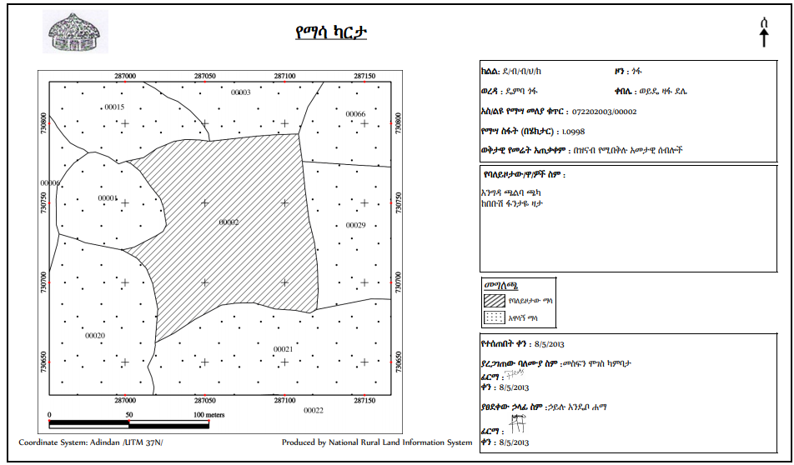
Standard map element of South nations, nationalities and peoples of Ethiopia

Slide 31
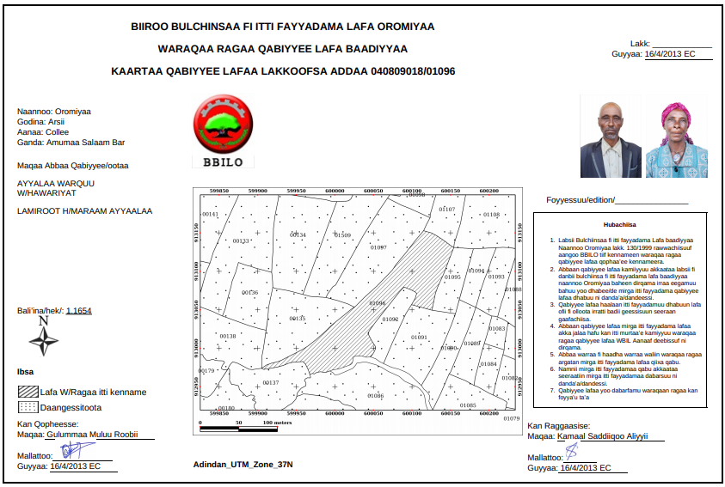
Standard map element of Oromia region

Slide 32
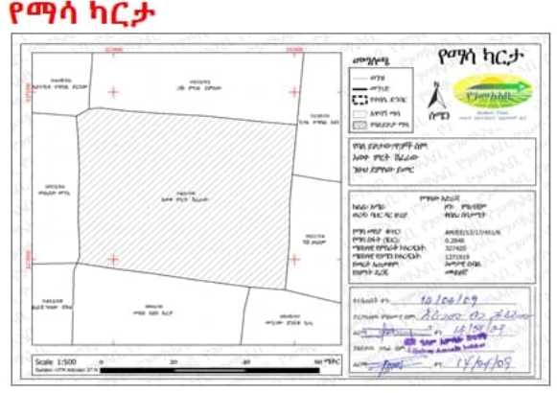
Standard map element of Amhara region

Slide 33
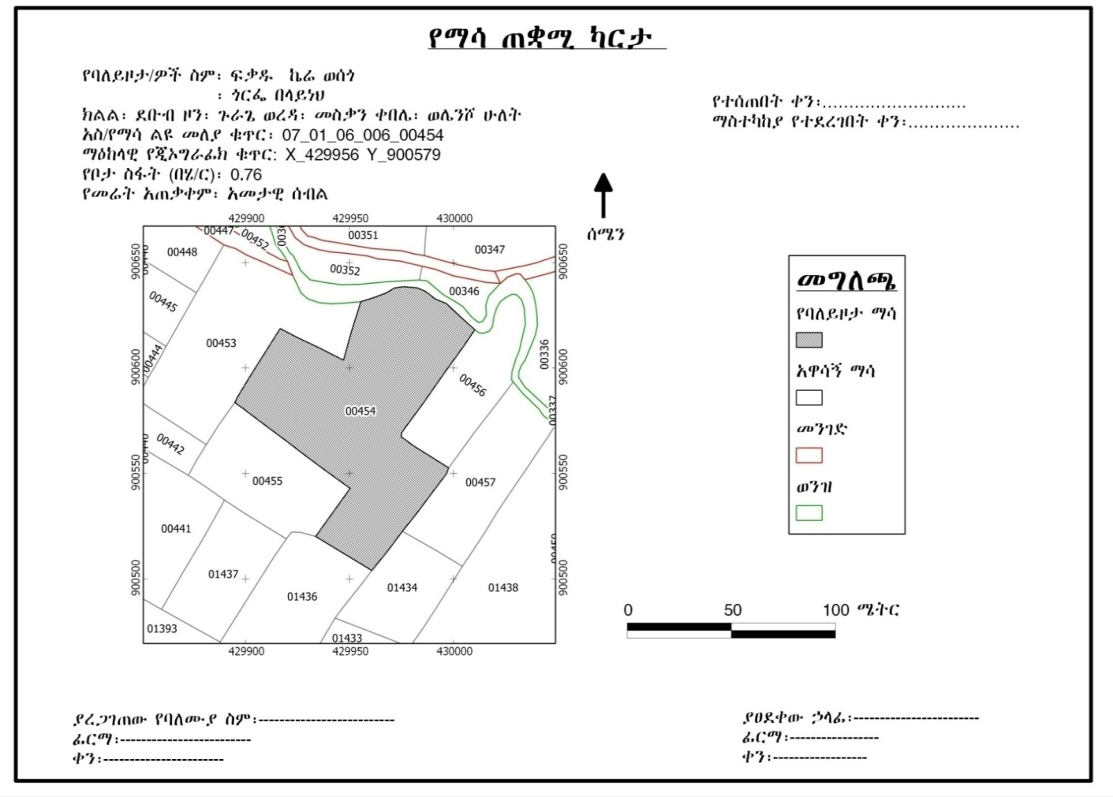
end result

Slide 34
Skills to develop
Adding Existing Map Template
Creating New Map Template
Preparing Parcel Map Based On the Regional Template
Rule-based Rendering
Printing Final Parcel Map Certificate (generate atlas)
Parcel Map Issuing and Documentation

Slide 35
Actvity
Discuss the use of Atlas?
What is Rule-based rendering?

